Slide 1
Lecture 15
Main Memory (part 2)

Slide 2
Paging
Logical address space of a process can be noncontiguous; process is allocated physical memory whenever the latter is available
Divide physical memory into fixed-sized blocks called frames (size is power of 2, between 512 bytes and 8,192 bytes)
Divide logical memory into blocks of same size called pages
Keep track of all free frames
To run a program of size n pages, need to find n free frames and load program
Set up a page table to translate logical to physical addresses
Internal fragmentation

Slide 3
Address Translation Scheme
Address generated by CPU is divided into:
  Page number (p) – used as an index into a page table which contains base address of each page in physical memory
  Page offset (d) – combined with base address to define the physical memory address that is sent to the memory unit
  For given logical address space 2^{m} and page size 2^{n}
page number
page offset
p
d
m - n
n

Slide 4
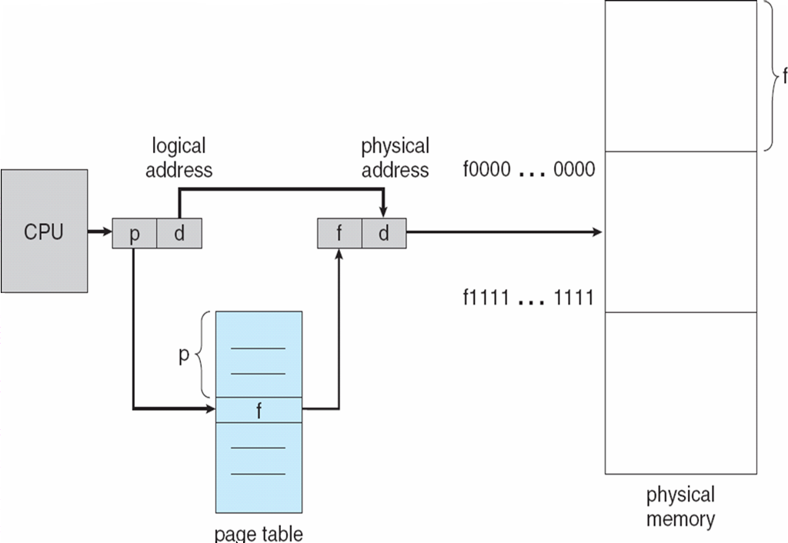
Paging Hardware

Slide 5

Paging Model of Logical and Physical Memory

Slide 6

Paging Example
32-byte memory and 4-byte pages

Slide 7

Free Frames
Before allocation
After allocation

Slide 8
Implementation of Page Table
Page table is kept in main memory
Page-table base register (PTBR) points to the page table
Page-table length register (PRLR) indicates size of the page table
In this scheme every data/instruction access requires two memory accesses. One for the page table and one for the data/instruction.
The two memory access problem can be solved by the use of a special fast-lookup hardware cache called associative memory or translation look-aside buffers (TLBs)
Some TLBs store address-space identifiers (ASIDs) in each TLB entry – uniquely identifies each process to provide address-space protection for that process

Slide 9
Associative Memory
Associative memory – parallel search
Address translation (p, d)
  If p is in associative register, get frame # out
  Otherwise get frame # from page table in memory
Page #
Frame #

Slide 10

Paging Hardware With TLB

Slide 11
Memory Protection
Memory protection implemented by associating protection bit with each frame
Valid-invalid bit attached to each entry in the page table:
  “valid” indicates that the associated page is in the process’ logical address space, and is thus a legal page
  “invalid” indicates that the page is not in the process’ logical address space

Slide 12

Valid (v) or Invalid (i) Bit In A Page Table
System with a 14-bit address space: 0 to 16383
Program that uses only addresses 0 to 10468
Page size 2KB

Slide 13
Shared Pages
Shared code
  One copy of read-only (reentrant) code shared among processes (i.e., text editors, compilers, window systems).
  Shared code must appear in same location in the logical address space of all processes
Private code and data
  Each process keeps a separate copy of the code and data
  The pages for the private code and data can appear anywhere in the logical address space

Slide 14
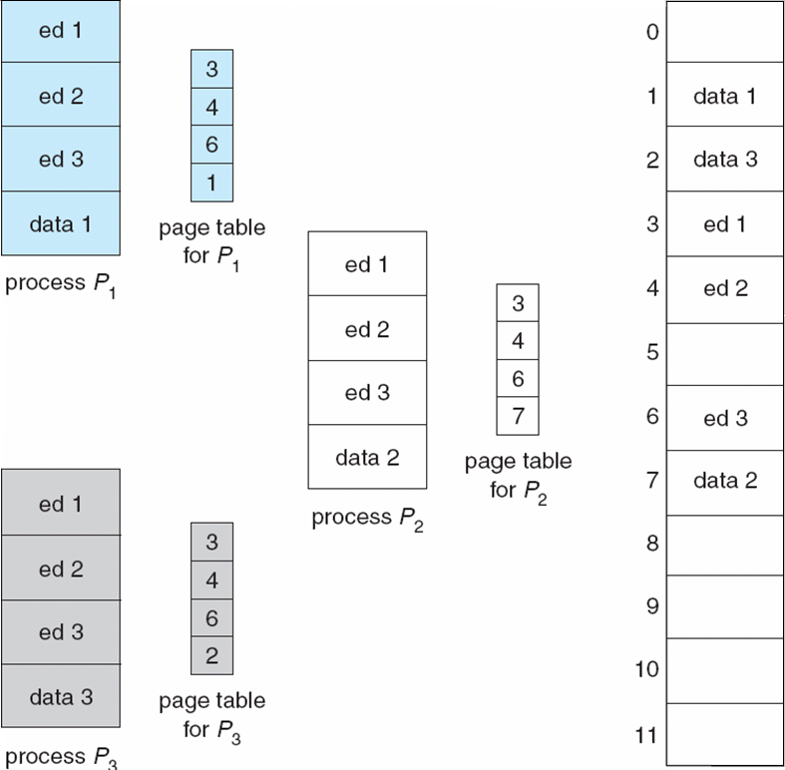
Shared Pages Example

Slide 15
Segmentation
Memory-management scheme that supports user view of memory
A program is a collection of segments
  A segment is a logical unit such as:
main program
procedure
function
method
object
local variables, global variables
common block
stack
symbol table
arrays

Slide 16

User’s View of a Program

Slide 17
Logical View of Segmentation
1
1
4
2
3
4
2
3
user space
physical memory space

Slide 18
Segmentation Architecture
Logical address consists of a two tuple:
<segment-number, offset>,
Segment table – maps two-dimensional physical addresses; each table entry has:
  base – contains the starting physical address where the segments reside in memory
  limit – specifies the length of the segment
Segment-table base register (STBR) points to the segment table’s location in memory
Segment-table length register (STLR) indicates number of segments used by a program;
  segment number s is legal if s < STLR

Slide 19
Segmentation Architecture (Cont.)
Protection
  With each entry in segment table associate:
    validation bit = 0 ⇒ illegal segment
    read/write/execute privileges
Protection bits associated with segments; code sharing occurs at segment level
Since segments vary in length, memory allocation is a dynamic storage-allocation problem
A segmentation example is shown in the following diagram

Slide 20
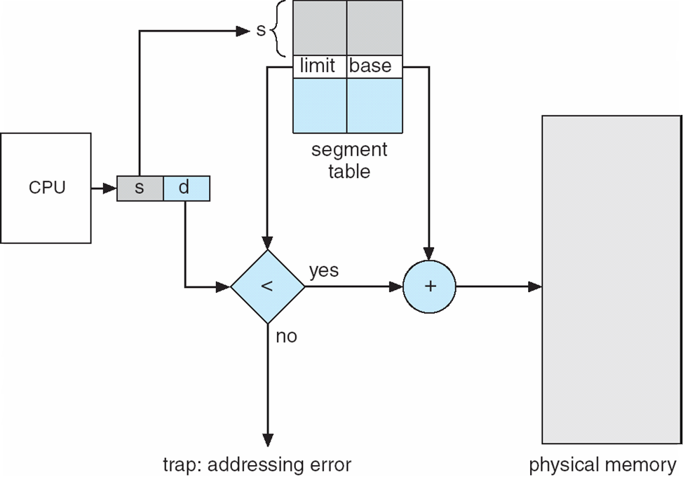
Segmentation Hardware

Slide 21
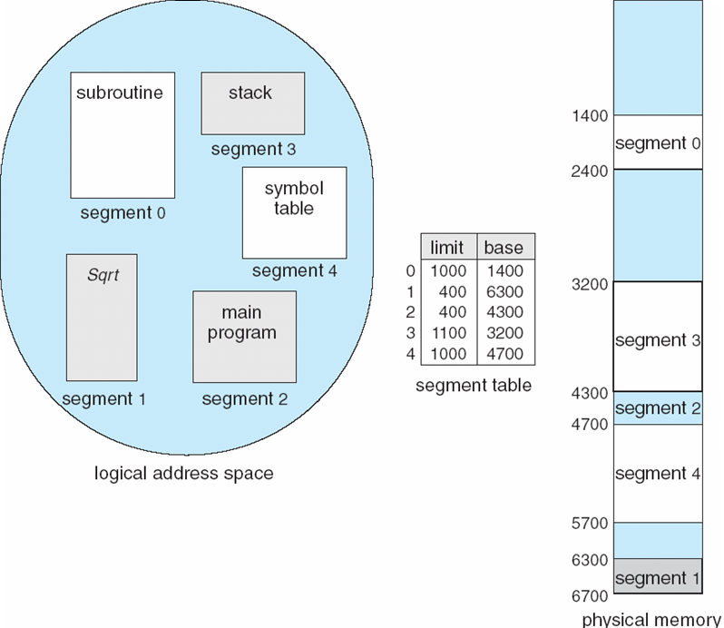
Example of Segmentation

Slide 22
Example: The Intel Pentium
Supports both segmentation and segmentation with paging
CPU generates logical address
  Given to segmentation unit
    Which produces linear addresses
  Linear address given to paging unit
    Which generates physical address in main memory
    Paging units form equivalent of MMU

